Slide 1
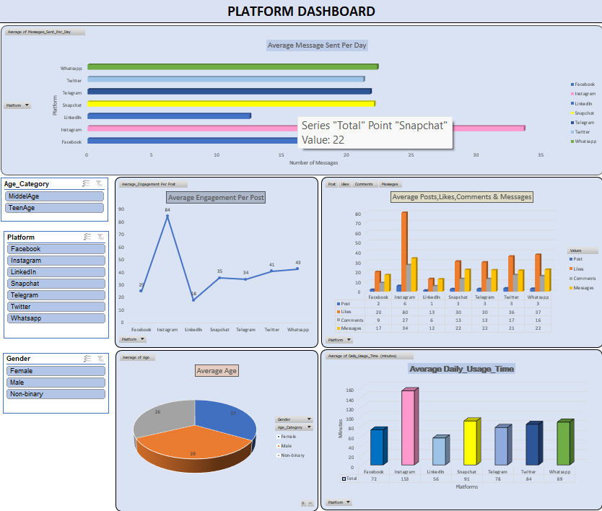
Social-Media Dashboard
Summary : Our social media dashboard provides a comprehensive overview of our digital presence and audience engagement across various platforms. It tracks and analyzes key metrics to inform our marketing strategies and measure our performance against set goals.

Slide 2
Purpose: The dashboard serves as a visual tool to track and analyze the performance of social media activities, providing insights into audience behavior and campaign effectiveness.
Key Metrics :
Engagement Metrics: Likes, comments and overall user interaction.
Content Performance: Analysis of which types of posts generate the most engagement.
Filtering: By date range, platform, or content type for targeted analysis.
Follower Demographics: Age, gender, location, and interests of the audience.
Average Daily Usage Time: We can see what the average time people spend bases on social media platform.
Slicer: Used slicer on gender ,platforms and age category.

Slide 3
List of Questions which we solve further with visualizations
Perform Data Cleaning
Show what’s the Average daily usage time of social media platforms
Give details of post, likes, comments & messages
Show what’s the Average Engagement Per Post
Which platform use most for conversation
Add slicer based on Gender, Social-Media, Age-Category

Slide 4
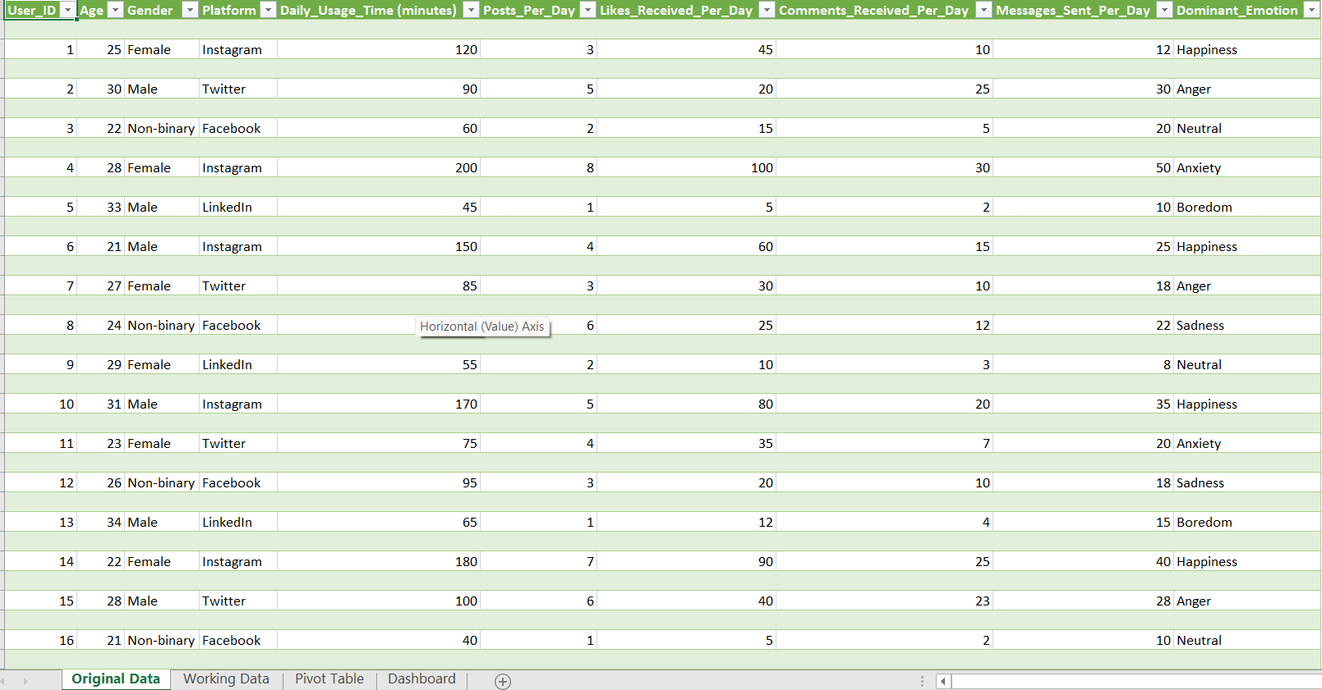
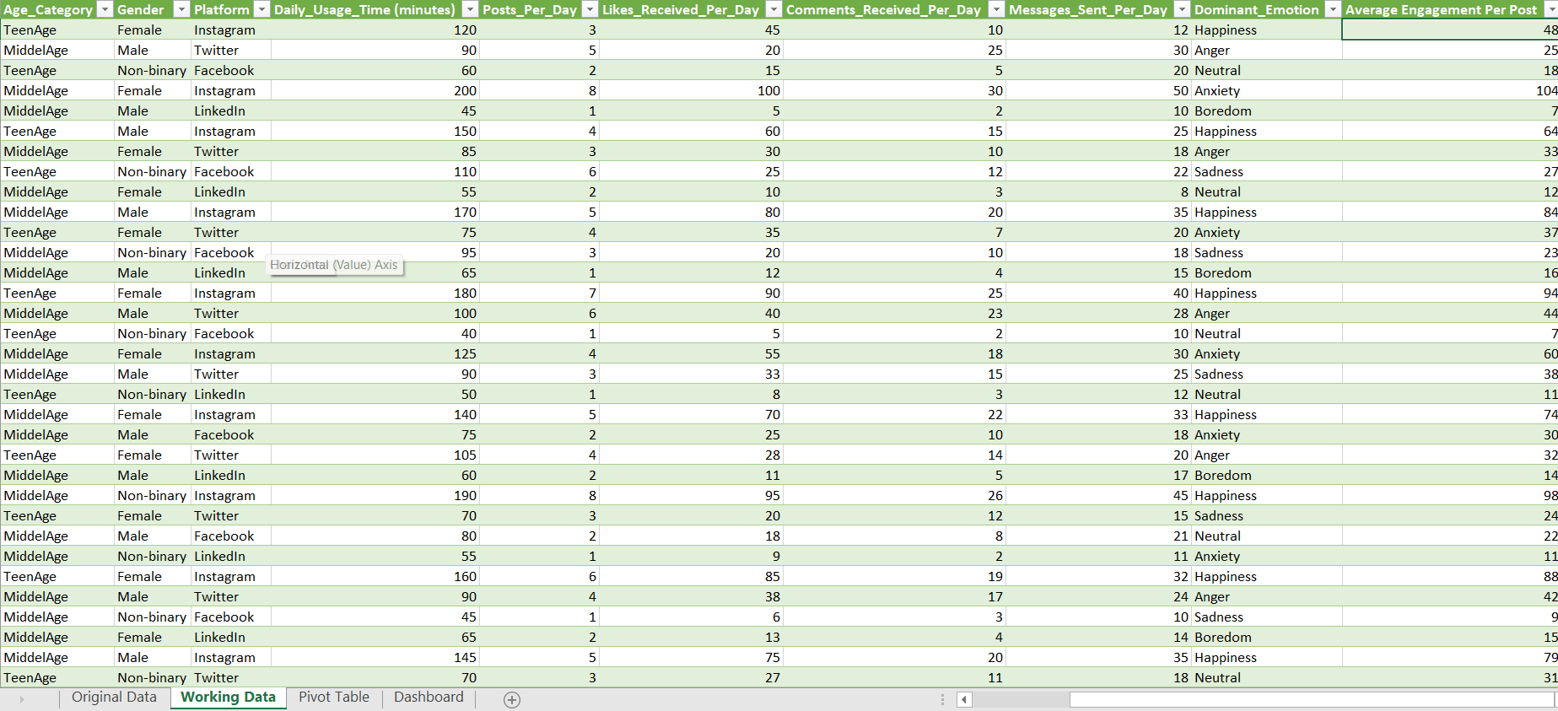
Performed data cleaning
Before Data Cleaning
After Data Cleaning

Slide 5
Average daily usage time of social media platforms
“Average Daily Usage Time” which compares the average time spent by users on various social media platforms. Here’s a summary:
Instagram: Highest usage time, with a peak at approximately 150 minutes.
Facebook: Significant usage, with times around 70 and 80 minutes.
LinkedIn: Moderate usage, with times around 50 and slightly above 60 minutes.
Snapchat: Around 90 minutes of usage.
Telegram: Similar to Facebook, with times around 70 and slightly above 80 minutes.
Twitter: Comparable to LinkedIn, with times around 70 minutes.
WhatsApp: Close to Twitter’s usage times.
This graph is useful for understanding user engagement and can inform decisions related to marketing and content strategy on these platforms.

Slide 6
Give Details of post, likes, comments & messages
Title: Average Posts, Likes, Comments & Messages
Platforms : Facebook, Instagram, LinkedIn, Snapchat, Telegram, Twitter, WhatsApp.
Metrics Represented:
Posts (Blue Bars): Varying average number of posts per platform.
Likes (Orange Bars): Facebook shows a high number of likes.
Comments (Gray Bars): Comparative average comments across platforms.
Messages (Yellow Bars): Average messages sent per platform.
This bar chart offers a visual comparison of engagement metrics across popular social media platforms, which can be useful for analyzing social media strategy and audience engagement.

Slide 7
Show what’s the Average Engagement Per Post
“Average Engagement Per Post” which compares the average engagement numbers for different social media platforms. Here’s a brief summary:
Instagram: Leads with the highest engagement at 84.
WhatsApp: Follows with an engagement level of 43.
Twitter: Close behind with an engagement level of 41.
Other Platforms: Facebook (28), LinkedIn (35), Snapchat (34), and Telegram (8) show lower engagement numbers.
This graph is useful for understanding which platforms may yield better engagement for posts, which is valuable for social media strategy planning.

Slide 8
Which platform use most for conversation
“Average Messages Sent Per Day,” which compares the messaging activity on various social media platforms. Here’s a brief summary:
Instagram Has the highest average messages sent per day.
Other Platforms: Facebook, Twitter, Telegram, Snapchat, LinkedIn , WhatsApp are also included, with varying average messages sent.
This graph provides insights into the preferred platforms for messaging, which can be valuable for understanding communication trends and platform popularity.

Slide 9
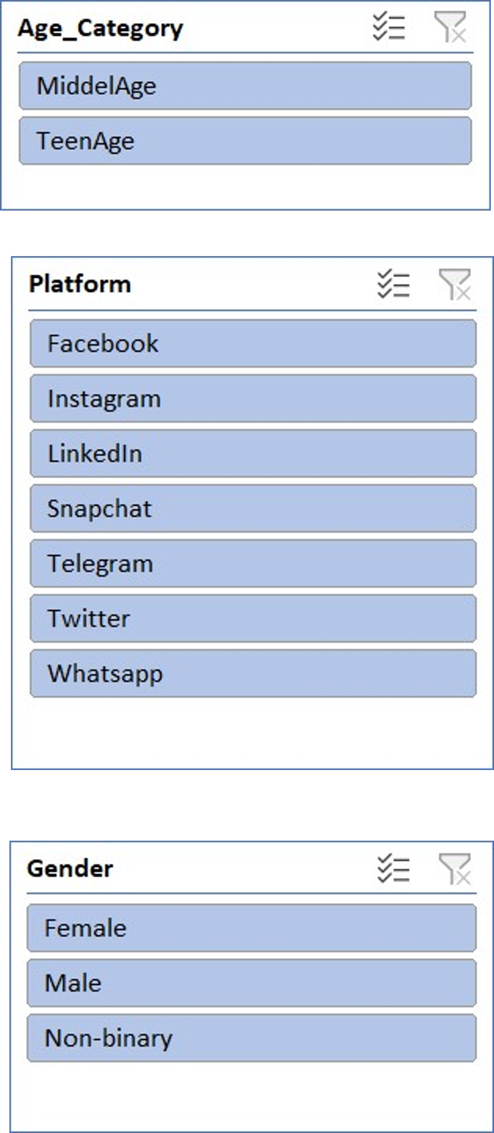
Add slicer based on Gender, Social-Media, Age-Category
Age Category: Includes options like “Middel Age,” indicating the form captures age-related data.
Platform: Lists social media platforms such as Facebook, Instagram, LinkedIn, etc., for respondents to select from.
Gender: Offers choices like Female, Male, and Non-binary, showing the form’s inclusivity in gender identification.
This form seems to be designed for collecting user data related to social media usage across various demographics. It’s a useful tool for understanding audience preferences and behaviors on different platforms.

